Slide 1


Modern NLP
Based on Deep Learning and Language models.
Day 2 Afternoon
Alexandre Gazagnes

Slide 2
2nd Day
Morning (~ 2h)
Smallest remainder of Day 1
King – Man + Woman
Using advanced embedding techniques
Afternoon (~ 4h)
Gentle introduction to delivery API + front End
Transfert learning
Fine Tuning
Alexandre Gazagnes
Alexandre Gazagnes

Slide 3
First … Let’s Talk !

Slide 4
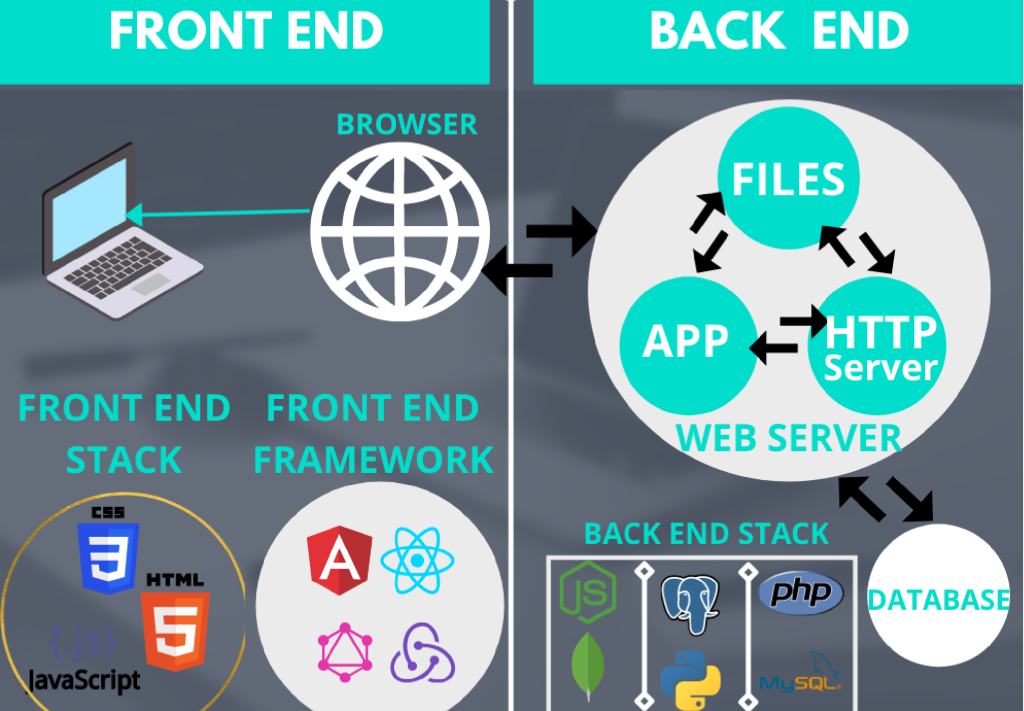
Back vs Front ?

Slide 5
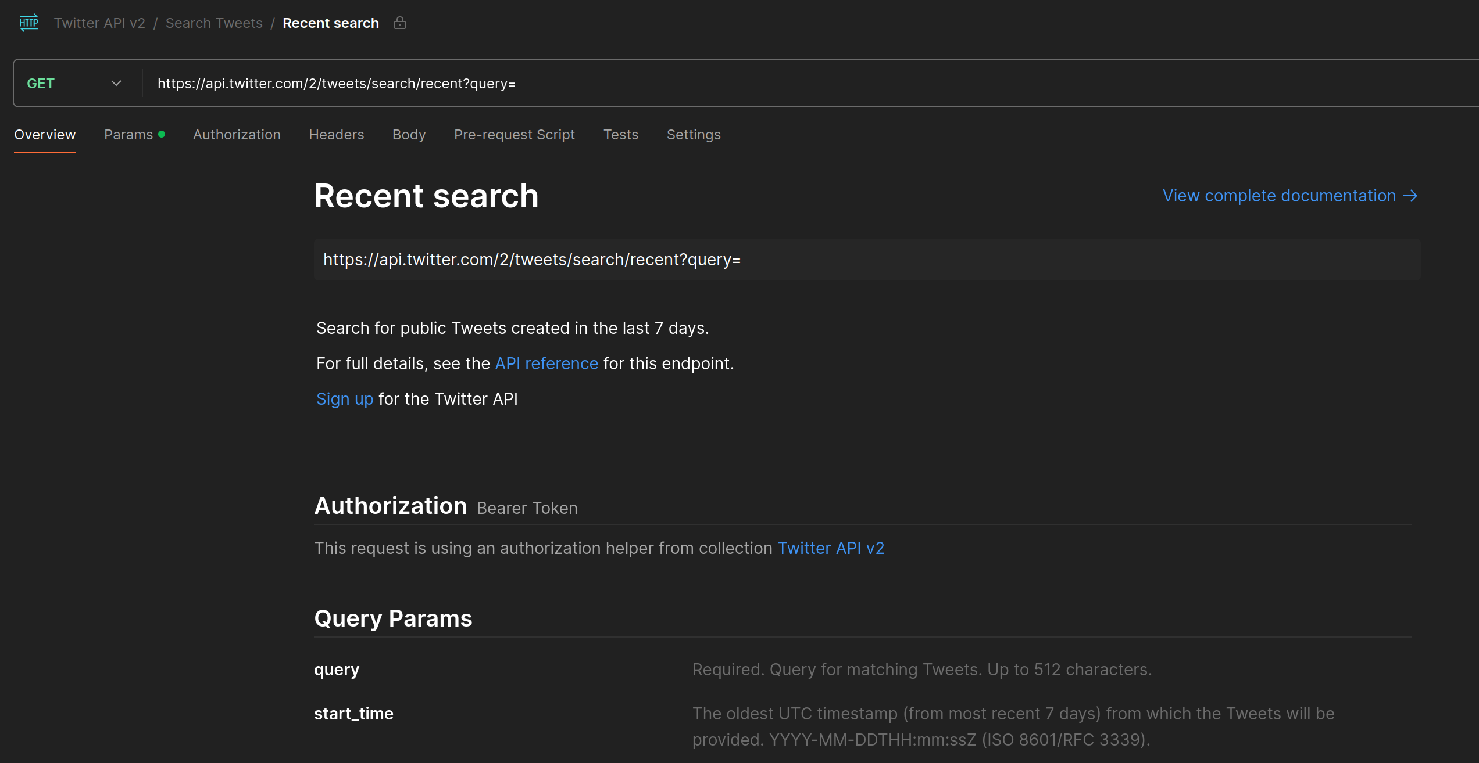
What is Back-End / API ?

Slide 6
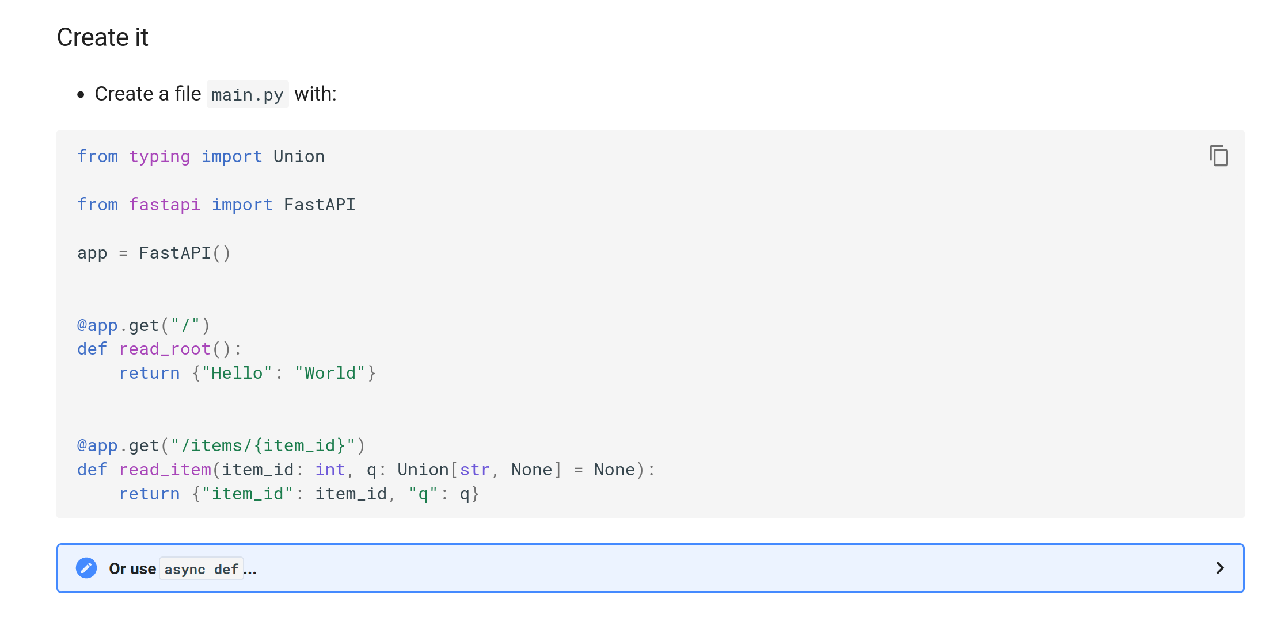
Fast API

Slide 7
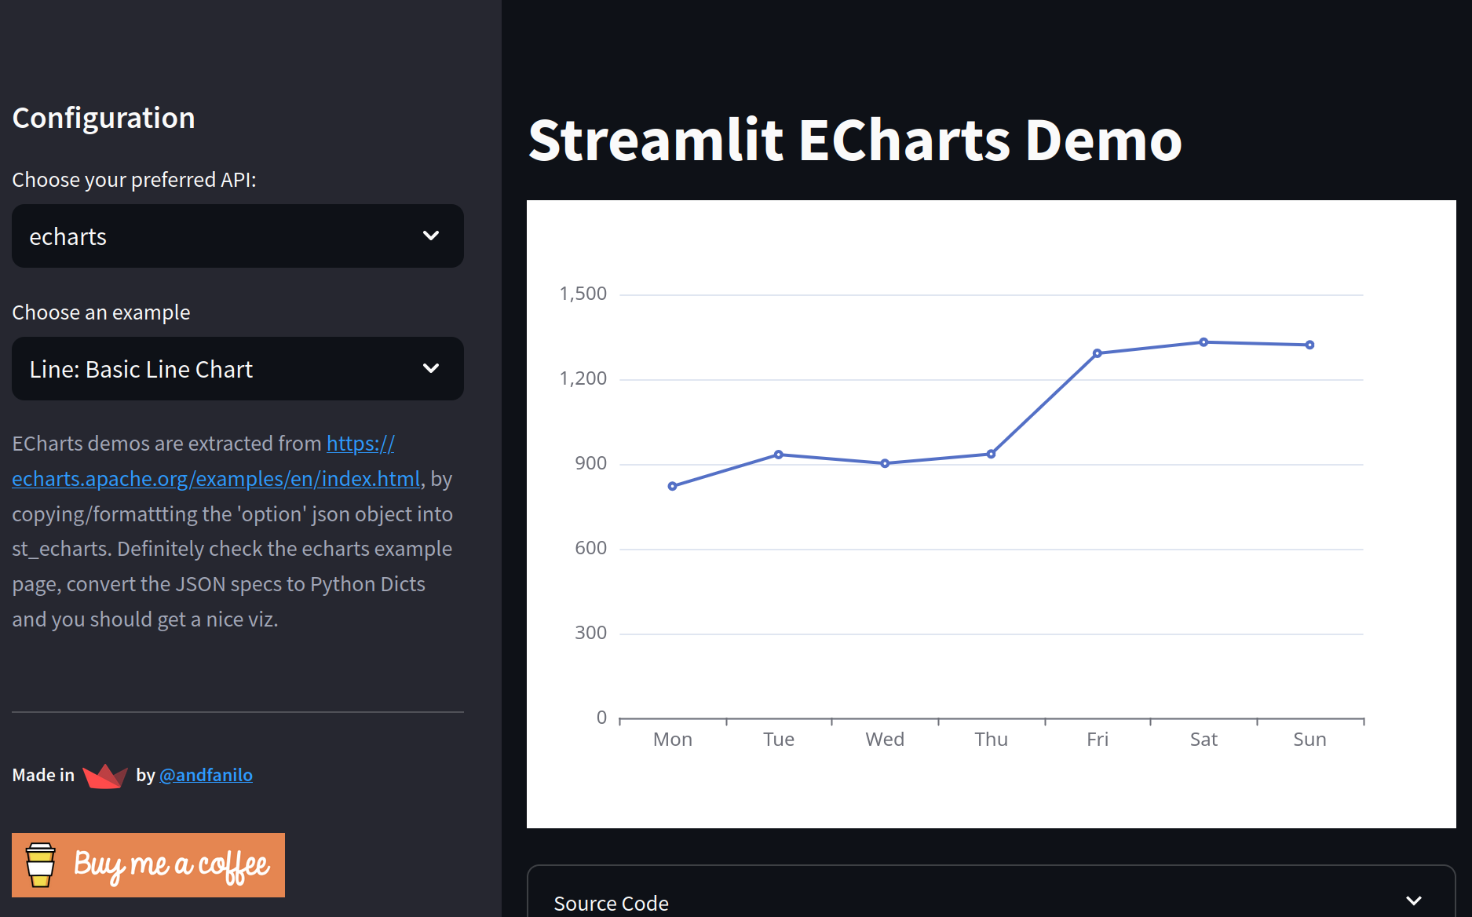
What is Front End

Slide 8
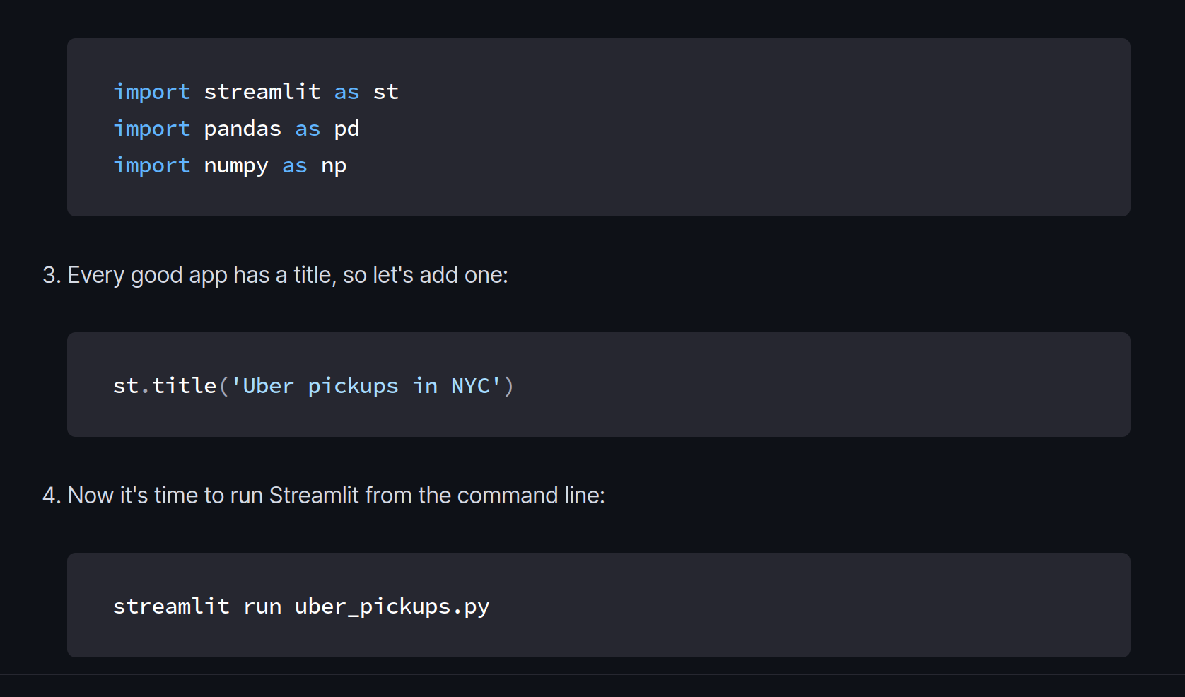
Streamlit

Slide 9
Streamlit

Slide 10
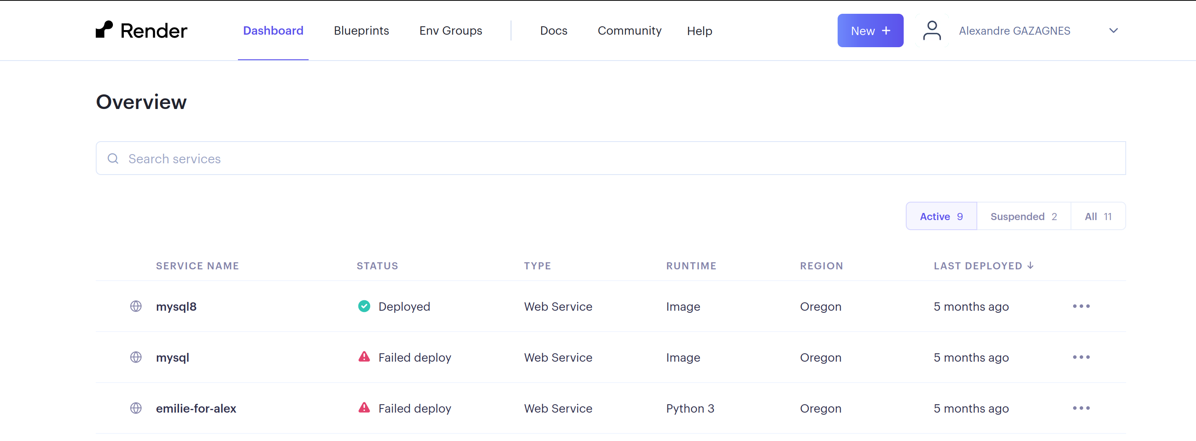
Production Back

Slide 11
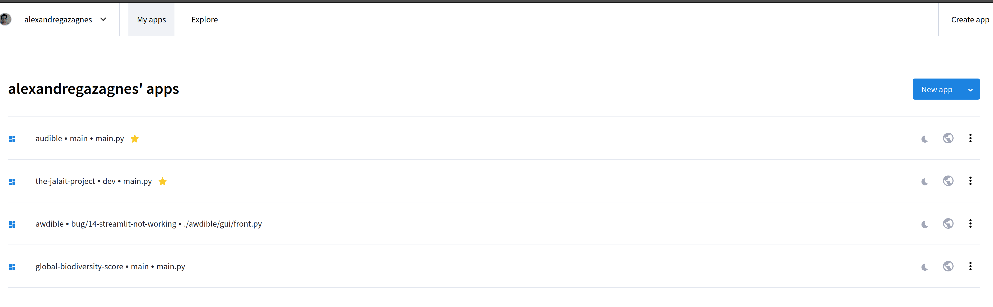
Production Front

Slide 12
Practice ! (FreeStyle ;) )

Slide 13
NLP Tasks with pretrained models

Slide 14
What is a pretrained model ?
A pretrained model is a neural network that has been trained on a large dataset and can be used directly on your data or as a starting point for other tasks.
These models can save a significant amount of time and computational resources, as it is not necessary to train a model from scratch on a new task.
Finetuning is the process of further training a pretrained model on a specific task using task-specific data (usually small dataset). The degree of finetuning varies depending on the size and similarity of the new task to the pretraining task.

Slide 15
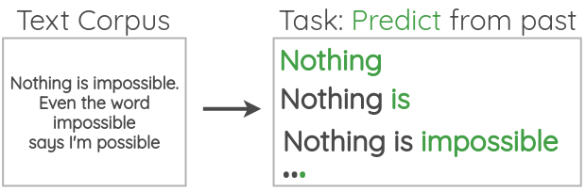
Large language models case
LLM model is presented with a large dataset of text and is then trained to predict the next word in a sequence of words (Self-supervised learning).
Large language models have achieved state-of-the-art performance on a wide range of natural language processing tasks, including language translation, text summarization, and question answering.

Slide 16
Most used pretrained models in NLP
Bard: Google's Bard, initially powered by the LaMDA model with 137 billion parameters, has been enhanced with the PaLM model, which has a staggering 540 billion parameters. The upgrade with PaLM significantly boosts Bard's functionality, including improved reasoning, multi-step prompt handling
LLaMA: Meta's family of LLaMA models, ranging from 7 to 65 billion parameters, provides a robust and efficient alternative for various NLP tasks, outperforming larger models in many benchmarks. Used in facebook for Content Moderation.
GPT: Developed by OpenAI, it is a transformer-based model with over 175 billion parameters for GPT3, trained on a dataset of petabytes of data collected over 8 years of web crawling. GPT4 has almost one trillion parameters (the specific number of parameters for GPT-4 hasn't been publicly disclosed).

Slide 17
Classification & Sentiment Analysis
The process of determining the category or a given text. Sentiment Analysis is one of the most used case.
Examples:
Determining whether a customer review of a product is positive or negative.
Classifying a news article as belonging to a specific category (politics, sports, entertainment, etc.).

Slide 18
Zero-Shot Classification
Zero-shot classification is an NLP algorithm that can classify text data into a set of predefined categories or labels without the need for any labeled training data. Instead, the algorithm relies on natural language understanding and general knowledge to make predictions based on the input text and a set of given parameters.
Examples:
Classifying news articles into predefined topics such as politics, sports, and entertainment, without being trained on any specific labeled data for those categories. The algorithm relies on its ability to understand the language and the context of the articles to make accurate predictions.
Classifying customer feedback into different categories such as positive, negative, or neutral sentiments, without any labeled training data for sentiment analysis. The algorithm can use its understanding of language and common patterns in text to identify the sentiment expressed in the feedback.
Classifying documents or texts into different languages, without any labeled data for language classification. The algorithm can analyze the input text's linguistic features and identify the most likely language based on its knowledge of language structure and patterns.
Classifying products or services into predefined categories based on their features and characteristics, without any labeled data for product classification. The algorithm can analyze the text describing the product's features and characteristics and classify it into the most appropriate category based on its understanding of the product domain.

Slide 19
Information Extraction & Questing Answering
The process of extracting specific information from a text and answering questions based on that information.
Examples:
Extracting information about a person from a Wikipedia article and answering questions about their education and career.
Extracting information about a company from a financial report and answering questions about their revenue and profits.

Slide 20
Translation
The process of converting text from one language to another.
Example:
Translating a Spanish news article into English.
These models can also be adopted to generate voice : Text-to-Speech

Slide 21
Summarization
The process of condensing a text to its main points or key information.
Examples:
Summarizing a long research paper into a brief summary for a conference presentation.
Summarizing a news article about a complex legal case into a summary for a non-legal audience.

Slide 22
Topic Modeling
The goal of topic modeling is to uncover the underlying structure and patterns in the data, and to group together documents that are related to each other based on their content.
Topic modeling algorithms typically use techniques such as latent Dirichlet allocation (LDA) to identify the underlying topics present in a set of documents. These topics may be represented as a set of keywords or phrases, and each document may be assigned a probability distribution over the topics, indicating the degree to which it relates to each topic
Examples:
A news organization may use topic modeling to identify the most common themes and issues discussed in their articles, and to group similar articles together for easier organization and analysis.
A social media monitoring tool may use topic modeling to identify the most frequently discussed topics and hashtags on a particular platform, and to track changes in these topics over time.

Slide 23
Text Generation & Prompting
The process of creating new text based on a given input or set of parameters.
Prompting refers to the process of providing input, context and/or starting point for a text generation.
Examples:
Generating personalized email responses based on the recipient's name and previous interactions with the company.
Generating product descriptions for an e-commerce website based on the product's features and target audience.
Generating creative headlines for news articles based on the content of the article.
Generating social media posts for a brand based on current events and trending topics.

Slide 24
Evaluation
There are several common evaluation metrics used in natural language processing (NLP) tasks, depending on the specific task and dataset. Some of the most common metrics include:
Accuracy: This is the most basic and commonly used metric, which simply calculates the percentage of correctly predicted labels or outputs.
Precision, Recall and F1-score: These are used for classification tasks and take into account both true positives and false positives. Precision is the number of true positives divided by the number of true positives and false positives, recall is the number of true positives divided by the number of true positives and false negatives, and F1-score is the harmonic mean of precision and recall.
BLEU, ROUGE and METEOR: These are used for text generation tasks such as machine translation, summarization, and text completion. BLEU compares the generated text to one or more reference texts, ROUGE compares the generated text to a reference text, and METEOR compares the generated text to a reference text, taking into account synonyms and stemming.
It is important to note that these metrics should be chosen based on the specific NLP task, and that a single metric may not provide a complete picture of the model's performance.

Slide 25
Practice !

Slide 26
Annexes

Slide 27
Annexes
To find dataset you can start by exploiting:
https://datasetsearch.research.google.com/
https://huggingface.co/datasets/viewer/

Slide 28
NLP in Practice: Project Work

Slide 29
Conduct a study about trends in healthy food in 2022. This project could involve the following steps:
Collecting data on healthy food trends by scraping relevant information from websites, blogs, and social media platforms.
Preprocessing the collected data by cleaning, normalizing, and tokenizing the text
Using NLP techniques such as sentiment analysis, topic modeling, and named entity recognition to analyze the data and uncover trends in healthy food.
Visualizing the results using charts and graphs to make the findings more clear and actionable.
Creating a report or presentation summarizing the findings and discussing their implications for the healthy food industry.
This project would allow students to apply their NLP skills to a real-world problem and gain a better understanding of trends in healthy food. Additionally, it could be possible to share the findings with relevant stakeholders in the food industry and potentially have an impact.

Slide 30
Collecting data on healthy food trends
One example of where you could collect data for this NLP project on healthy food trends in 2022 would be from social media platforms such as Twitter, Instagram, and Facebook. You could use the social media APIs to access data on posts and comments related to healthy food, such as those containing keywords like "organic," "plant-based," "gluten-free," etc. You could also use hashtags such as #healthyeating or #plantbaseddiet to find relevant content.
Another example would be scraping websites that specialize in healthy food recipes and nutrition information, such as Whole Foods, EatingWell, and Healthline. These websites contain a lot of useful information on healthy food trends, such as recipes, ingredients, and nutritional information.

Slide 31
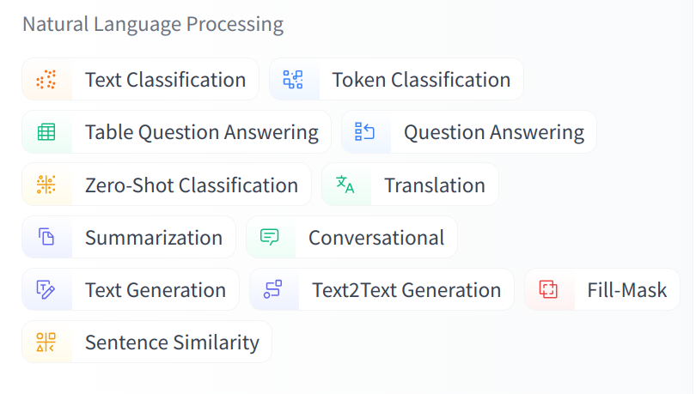
HuggingFace NLP Tasks classification

Slide 32
https://github.com/wandb/examples
https://wandb.ai/ayush-thakur/huggingface/reports/How-To-Fine-Tune-HuggingFace-Transformers-on-a-Custom-Dataset--Vmlldzo0MzQ2MDc

Slide 33
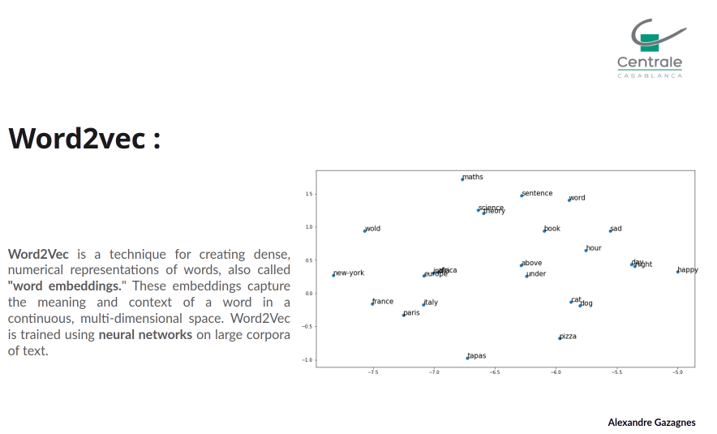

Slide 34
Any Business ideas, techs projects to bring in ?
.
.
.
.
Alexandre Gazagnes
Alexandre Gazagnes

Slide 35
Usage in the food industry
Here are some examples:
Recipe generation: Generate new recipes based on a given set of ingredients or dietary restrictions.
Nutritional analysis: Extract nutritional information from food labels or recipes, making it easier for consumers to track their intake or for companies to comply with regulatory requirements.
Food safety monitoring: Analyze social media posts or news articles for mentions of food safety incidents or outbreaks, allowing companies to identify and address potential issues more quickly.

